Slide 1
Figure 1. Employment share in three major industry sectors in the Research Triangle, 1980, 2000, and 2013. Source: Authors’ calculations using the US Census and ACS from IPUMS.

Slide 2
Data for Figure 1:
sector | pwrkhrs_80 | pwrkhrs_00 | pwrkhrs_13
Government | 129555300 | 181505695 | 241370723
High-Tech Industries | 81597540 | 271123194 | 321446583
Non-High-Tech Industries | 310854600 | 651027920 | 909700086.5
 | 522007440 | 1103656809 | 1472517393
sector | 1980 | 2000 | 2013
Government | 24.82% | 16.45% | 16.39%
High-Tech Industries | 15.63% | 24.57% | 21.83%
Non-High-Tech Industries | 59.55% | 58.99% | 61.78%
 | 100.00% | 100.00% | 100.00%

Slide 3
Fig. 2. Employment share by gender in four main occupation groups in the Research Triangle, 1980-2013. (a) Males and females, (b) males only, (c) females only.

Slide 4
 | Total
 | 1980 | 1990 | 2000 | 2005 | 2013
Managers/Professionals | 40.3% | 49.9% | 53.0% | 56.3% | 57.3%
Blue-Collar Middle-Skill | 26.2% | 19.5% | 17.7% | 16.1% | 13.2%
Clerical/Retail Sales | 24.7% | 21.8% | 20.2% | 18.1% | 16.5%
Low-Skill Services | 8.8% | 8.8% | 9.1% | 9.5% | 13.1%
Total | 100.0% | 100.0% | 100.0% | 100.0% | 100.0%
Data for Figure 2:
 | Male
 | 1980 | 1990 | 2000 | 2005 | 2013
Managers/Professionals | 25.3% | 29.2% | 30.3% | 31.8% | 30.1%
Blue-Collar Middle-Skill | 20.3% | 15.4% | 14.7% | 13.7% | 11.2%
Clerical/Retail Sales | 8.2% | 6.7% | 7.2% | 7.1% | 6.2%
Low-Skill Services | 3.8% | 4.1% | 4.2% | 4.7% | 6.2%
Total | 57.5% | 55.4% | 56.5% | 57.3% | 53.7%
 | Female
 | 1980 | 1990 | 2000 | 2005 | 2013
Managers/Professionals | 14.9% | 20.7% | 22.7% | 24.4% | 27.2%
Blue-Collar Middle-Skill | 6.0% | 4.1% | 2.9% | 2.4% | 2.0%
Clerical/Retail Sales | 16.5% | 15.1% | 13.0% | 10.9% | 10.2%
Low-Skill Services | 5.1% | 4.7% | 4.9% | 4.9% | 6.9%
Total | 42.5% | 44.6% | 43.5% | 42.7% | 46.3%

Slide 5
Fig. 3. Change in employment share by gender in four main occupation groups in the Research Triangle, 1980-2013.

Slide 6
 | Male
 | 1980 | 1990 | 2000 | 2005 | 2013 | % Change (1980-2013)
Managers/Professionals | 25.3% | 29.2% | 30.3% | 31.8% | 30.1% | 19.0%
Blue-Collar Middle-Skill | 20.3% | 15.4% | 14.7% | 13.7% | 11.2% | -44.9%
Clerical/Retail Sales | 8.2% | 6.7% | 7.2% | 7.1% | 6.2% | -24.1%
Low-Skill Services | 3.8% | 4.1% | 4.2% | 4.7% | 6.2% | 65.4%
Total | 57.5% | 55.4% | 56.5% | 57.3% | 53.7%
Data for Figure 3:
 | Female
 | 1980 | 1990 | 2000 | 2005 | 2013 | % Change (1980-2013)
Managers/Professionals | 14.9% | 20.7% | 22.7% | 24.4% | 27.2% | 82.0%
Blue-Collar Middle-Skill | 6.0% | 4.1% | 2.9% | 2.4% | 2.0% | -66.4%
Clerical/Retail Sales | 16.5% | 15.1% | 13.0% | 10.9% | 10.2% | -37.9%
Low-Skill Services | 5.1% | 4.7% | 4.9% | 4.9% | 6.9% | 34.7%
Total | 42.5% | 44.6% | 43.5% | 42.7% | 46.3%

Slide 7
Fig. 4. Hourly wage ($2004) by gender in four main occupation groups in the Research Triangle, 1980-2013. Males and females (a), males only (b), females only (c).

Slide 8
Data for Figure 4:
 | Research Triangle |  |  |  |  |  |  | Research Triangle
 | 1980 | 1990 | 2000 | 2005 | 2013 |  |  | 1980 | 1990 | 2000 | 2005 | 2013
Managers | $15.16 | $18.38 | $21.32 | $22.84 | $22.31 |  | Managers | 100.00 | 121.23 | 140.63 | 150.68 | 147.20
Middle-Skill | $10.49 | $11.96 | $12.57 | $12.24 | $10.93 |  | Middle-Skill | 100.00 | 114.03 | 119.90 | 116.70 | 104.23
Clerical | $10.51 | $11.86 | $13.67 | $14.13 | $12.51 |  | Clerical | 100.00 | 112.78 | 129.99 | 134.38 | 119.02
Low-Skill | $7.33 | $8.57 | $9.24 | $8.87 | $7.89 |  | Low-Skill | 100.00 | 116.88 | 125.97 | 121.00 | 107.66
 | Male |  |  |  |  |  |  | Male
 | 1980 | 1990 | 2000 | 2005 | 2013 |  |  | 1980 | 1990 | 2000 | 2005 | 2013
Managers | $17.43 | $21.00 | $23.83 | $25.34 | $25.51 |  | Managers | 100.00 | 120.53 | 136.78 | 145.41 | 146.37
Middle-Skill | $11.23 | $12.52 | $12.99 | $12.60 | $11.18 |  | Middle-Skill | 100.00 | 111.44 | 115.64 | 112.16 | 99.55
Clerical | $13.84 | $14.61 | $15.97 | $17.08 | $14.65 |  | Clerical | 100.00 | 105.56 | 115.35 | 123.38 | 105.84
Low-Skill | $8.36 | $8.96 | $9.49 | $8.98 | $8.07 |  | Low-Skill | 100.00 | 107.19 | 113.60 | 107.52 | 96.53
 | Female |  |  |  |  |  |  | Female
 | 1980 | 1990 | 2000 | 2005 | 2013 |  |  | 1980 | 1990 | 2000 | 2005 | 2013
Managers | $12.18 | $15.38 | $18.50 | $20.13 | $19.34 |  | Managers | 100.00 | 126.23 | 151.86 | 165.20 | 158.70
Middle-Skill | $8.50 | $10.22 | $10.82 | $10.51 | $9.74 |  | Middle-Skill | 100.00 | 120.19 | 127.28 | 123.61 | 114.56
Clerical | $9.23 | $10.85 | $12.56 | $12.51 | $11.37 |  | Clerical | 100.00 | 117.52 | 135.98 | 135.52 | 123.11
Low-Skill | $6.64 | $8.22 | $9.01 | $8.76 | $7.74 |  | Low-Skill | 100.00 | 123.83 | 135.70 | 132.02 | 116.60

Slide 9
Unused Figures

Slide 10
Figure 5. Net change of jobs for males and females by high-tech industry status in Austin for 1980-2013. (a) High-tech industries, (b) non-high-tech industries. Source: Authors’ calculations using the US Census and ACS from IPUMS.

Slide 11
Data for Figure 5:
Austin | High Tech |  | Non-High Tech
 | Male | Female | Male | Female
Managers/Professionals | 77455 | 39201 | 116039 | 142826
Blue-Collar Middle-Skill | 11969 | 77 | 84853 | 13860
Clerical/Retail Sales | 15400 | 12518 | 42026 | 61501
Low-Skill Services | 14 | 411 | 56224 | 83533
Gender Totals | 104838 | 52207 | 299142 | 301720
Sector Totals | 157045 |  | 600862
City Total | 757907
Austin | High Tech |  | Non-High Tech
 | Male | Female | Male | Female
Managers/Professionals | 10.2% | 5.2% | 15.3% | 18.8%
Blue-Collar Middle-Skill | 1.6% | 0.0% | 11.2% | 1.8%
Clerical/Retail Sales | 2.0% | 1.7% | 5.5% | 8.1%
Low-Skill Services | 0.0% | 0.1% | 7.4% | 11.0%
Gender Totals | 13.8% | 6.9% | 39.5% | 39.8%
Sector Totals | 20.7% |  | 79.3%
City Total | 100.0%
Austin | High Tech |  | Non-High Tech
 | Male | Female | Male | Female
Managers/Professionals | 49.3% | 25.0% | 19.3% | 23.8%
Blue-Collar Middle-Skill | 7.6% | 0.0% | 14.1% | 2.3%
Clerical/Retail Sales | 9.8% | 8.0% | 7.0% | 10.2%
Low-Skill Services | 0.0% | 0.3% | 9.4% | 13.9%
Gender Totals | 66.8% | 33.2% | 49.8% | 50.2%
Sector Totals | 100.0% |  | 100.0%
Notes:
Add percentages of total
New figure: looking at HT / NHT, divide bars to stack Male and Female in number of jobs

Slide 12
Figure 2.1. Employment share within gender in four main occupation groups in Austin, 1980-2013. (a) Males, (b) females. Source: Authors’ calculations using the US Census and ACS from IPUMS.

Slide 13
Data for Figure 2.1:
 | Male
 | 1980 | 1990 | 2000 | 2005 | 2013
Managers/Professionals | 43.8% | 49.8% | 49.8% | 50.6% | 49.8%
Blue-Collar Middle-Skill | 34.9% | 27.3% | 27.7% | 27.9% | 26.9%
Clerical/Retail Sales | 13.6% | 14.6% | 14.9% | 13.3% | 12.6%
Low-Skill Services | 7.7% | 8.3% | 7.6% | 8.3% | 10.7%
Total | 100.0% | 100.0% | 100.0% | 100.0% | 100.0%
 | Female
 | 1980 | 1990 | 2000 | 2005 | 2013
Managers/Professionals | 35.1% | 46.1% | 48.5% | 50.7% | 51.1%
Blue-Collar Middle-Skill | 8.3% | 6.0% | 7.2% | 5.2% | 4.8%
Clerical/Retail Sales | 43.3% | 35.6% | 31.9% | 29.7% | 26.2%
Low-Skill Services | 13.2% | 12.3% | 12.4% | 14.4% | 18.0%
Total | 100.0% | 100.0% | 100.0% | 100.0% | 100.0%

Slide 14
Figure 5. Employment share by gender and education level for managers and related occupations in Austin, 1980-2013. Source: Authors’ calculations using the US Census and ACS from IPUMS.

Slide 15
Data for Figure 5:
Managers/Professionals in Austin |  | 1980 | 1990 | 2000 | 2005 | 2013
Male | Less than 4 Years of College | 26.5% | 23.1% | 20.4% | 20.9% | 18.9%
 | 4 Years of College or More | 37.9% | 35.9% | 39.1% | 39.8% | 37.3%
Female | Less than 4 Years of College | 16.8% | 18.9% | 15.2% | 13.6% | 13.4%
 | 4 Years of College or More | 18.8% | 22.1% | 25.3% | 25.8% | 30.5%
Total |  | 100.0% | 100.0% | 100.0% | 100.0% | 100.0%

Slide 16
Figure 6. Net change of jobs for males and females by high-tech industry status in Austin for 1980-2013. (a) Males and females, (b) males only, (c) females only. Source: Authors’ calculations using the US Census and ACS from IPUMS.
Notes:
Add graph of Austin as a whole, not separated by Gender

Slide 17
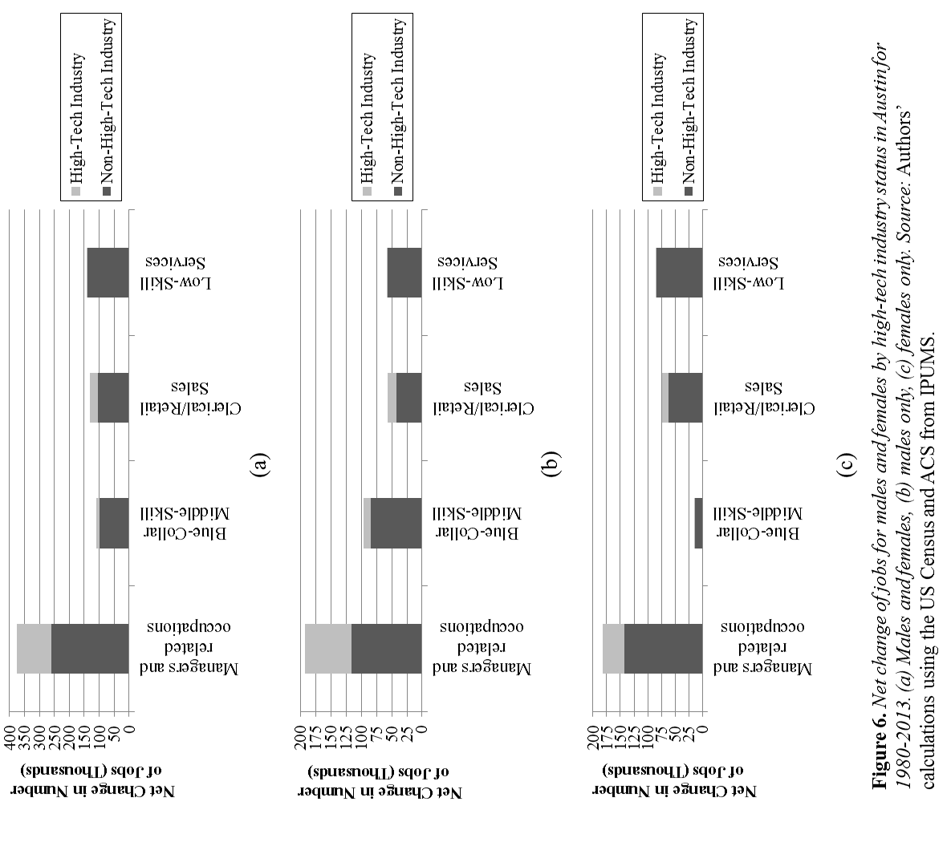

Slide 18
Data for Figure 6:
Austin | 1980 |  | 2013 |  | Net Change
 | High Tech | Non-High Tech | High Tech | Non-High Tech | High Tech | Non-High Tech
Managers/Professionals | 17300 | 85360 | 133956 | 344225 | 116656 | 258865
Blue-Collar Middle-Skill | 12380 | 52420 | 24426 | 151133 | 12046 | 98713
Clerical/Retail Sales | 10840 | 69440 | 38758 | 172967 | 27918 | 103527
Low-Skill Services | 680 | 35720 | 1105 | 175477 | 425 | 139757
Sector Totals | 41200 | 242940 | 198245 | 843802 | 157045 | 600862
Austin Total | 284140 |  | 1042047 |  | 757907
Male | 1980 |  | 2013 |  | Net Change
 | High Tech | Non-High Tech | High Tech | Non-High Tech | High Tech | Non-High Tech
Managers/Professionals | 13460 | 47220 | 90915 | 163259 | 77455 | 116039
Blue-Collar Middle-Skill | 8680 | 45900 | 20649 | 130753 | 11969 | 84853
Clerical/Retail Sales | 3020 | 19540 | 18420 | 61566 | 15400 | 42026
Low-Skill Services | 480 | 14700 | 494 | 70924 | 14 | 56224
Sector Totals | 25640 | 127360 | 130478 | 426502 | 104838 | 299142
Male Total | 153000 |  | 556980 |  | 403980
Female | 1980 |  | 2013 |  | Net Change
 | High Tech | Non-High Tech | High Tech | Non-High Tech | High Tech | Non-High Tech
Managers/Professionals | 3840 | 38140 | 43041 | 180966 | 39201 | 142826
Blue-Collar Middle-Skill | 3700 | 6520 | 3777 | 20380 | 77 | 13860
Clerical/Retail Sales | 7820 | 49900 | 20338 | 111401 | 12518 | 61501
Low-Skill Services | 200 | 21020 | 611 | 104553 | 411 | 83533
Sector Totals | 15560 | 115580 | 67767 | 417300 | 52207 | 301720
Female Total | 131140 |  | 485067 |  | 353927
City Total | 284140 |  | 1042047 |  | 757907
Notes:
Add percentages of total
New figure: looking at HT / NHT, divide bars to stack Male and Female in number of jobs

Slide 19
Data for Figure 6:
Austin | 1980 |  | 2013 |  | Net Change
 | High Tech | Non-High Tech | High Tech | Non-High Tech | High Tech | Non-High Tech
Managers/Professionals | 6.1% | 30.0% | 12.9% | 33.0% | 15.4% | 34.2%
Blue-Collar Middle-Skill | 4.4% | 18.4% | 2.3% | 14.5% | 1.6% | 13.0%
Clerical/Retail Sales | 3.8% | 24.4% | 3.7% | 16.6% | 3.7% | 13.7%
Low-Skill Services | 0.2% | 12.6% | 0.1% | 16.8% | 0.1% | 18.4%
Sector Totals | 14.5% | 85.5% | 19.0% | 81.0% | 20.7% | 79.3%
Austin Total | 100.0% |  | 100.0% |  | 100.0%
Male | 1980 |  | 2013 |  | Net Change
 | High Tech | Non-High Tech | High Tech | Non-High Tech | High Tech | Non-High Tech
Managers/Professionals | 4.7% | 16.6% | 8.7% | 15.7% | 10.2% | 15.3%
Blue-Collar Middle-Skill | 3.1% | 16.2% | 2.0% | 12.5% | 1.6% | 11.2%
Clerical/Retail Sales | 1.1% | 6.9% | 1.8% | 5.9% | 2.0% | 5.5%
Low-Skill Services | 0.2% | 5.2% | 0.0% | 6.8% | 0.0% | 7.4%
Sector Totals | 9.0% | 44.8% | 12.5% | 40.9% | 13.8% | 39.5%
Male Total | 53.8% |  | 53.5% |  | 53.3%
Female | 1980 |  | 2013 |  | Net Change
 | High Tech | Non-High Tech | High Tech | Non-High Tech | High Tech | Non-High Tech
Managers/Professionals | 1.4% | 13.4% | 4.1% | 17.4% | 5.2% | 18.8%
Blue-Collar Middle-Skill | 1.3% | 2.3% | 0.4% | 2.0% | 0.0% | 1.8%
Clerical/Retail Sales | 2.8% | 17.6% | 2.0% | 10.7% | 1.7% | 8.1%
Low-Skill Services | 0.1% | 7.4% | 0.1% | 10.0% | 0.1% | 11.0%
Sector Totals | 5.5% | 40.7% | 6.5% | 40.0% | 6.9% | 39.8%
Female Total | 46.2% |  | 46.5% |  | 46.7%
City Total | 100.0% |  | 100.0% |  | 100.0%
Notes:
Add percentages of total
New figure: looking at HT / NHT, divide bars to stack Male and Female in number of jobs

